Slide 1

Statistical Fundamentals:
Using Microsoft Excel for Univariate and Bivariate Analysis
Alfred P. Rovai
Linearity
PowerPoint Prepared by
Alfred P. Rovai
Microsoft® Excel® Screen Prints Courtesy of Microsoft Corporation.

Slide 2
Linearity
The assumption of linearity is that there is an approximate straight line relationship between two continuous variables. It is a common assumption in many bivariate procedures, such as bivariate correlation and regression analysis, because solutions are based on the general linear model (GLM).
If a relationship is nonlinear, the statistics that assume it is linear will either underestimate the strength of the relationship or fail to detect the existence of a relationship.
Methods of evaluating linearity:
  Draw on theory or prior research.
  Use a scatterplot. (Note: in regression analysis, nonlinearity is usually most evident in a plot of observed versus predicted values.)

Slide 3
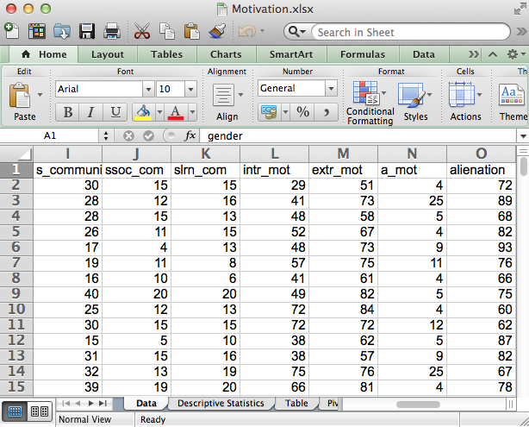
Open the dataset Motivation.sav.
File available at http://www.watertreepress.com/stats
TASK
Evaluate linearity for variables
powerlessness and normlessness.

Slide 4
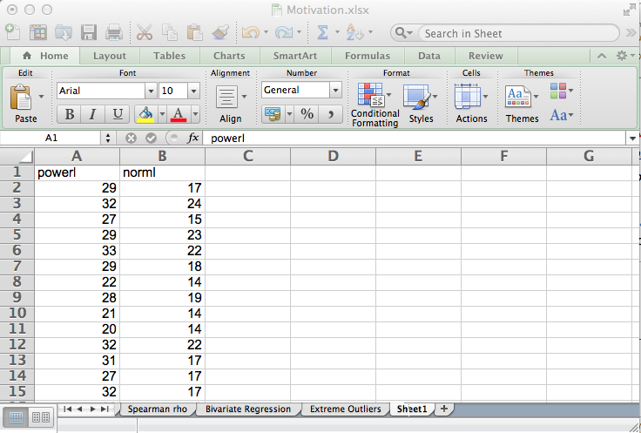
Copy variables powerlessness (powerl) and normlessness (norml) from the Data tab to columns A and B in an empty tab.
Click on cell A2 and hold the Shift key down while clicking on cell B170 to select cells A2:B170.
Click on the Excel Charts tab and insert a Marked Scatterplot.

Slide 5
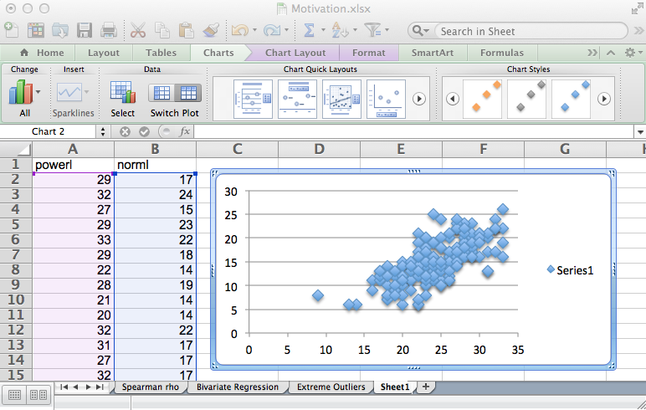
Highlight the Legend (Series 1) and hit the Delete key to delete the legend.
Select any Marker and double-click to open the Format Data Series dialog.

Slide 6
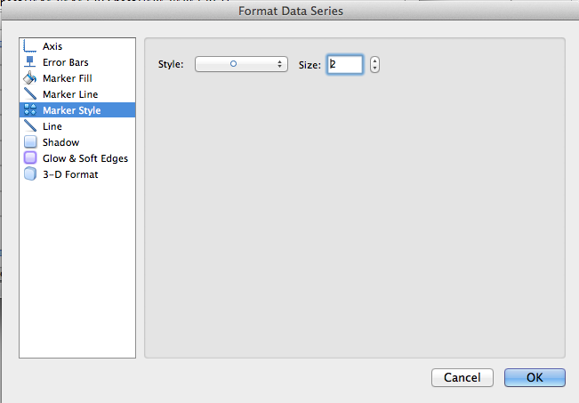
Change Marker Style to a circle and size from 9 (default) to 2 in order to facilitate interpretation of the scatterplot. Click OK.

Slide 7
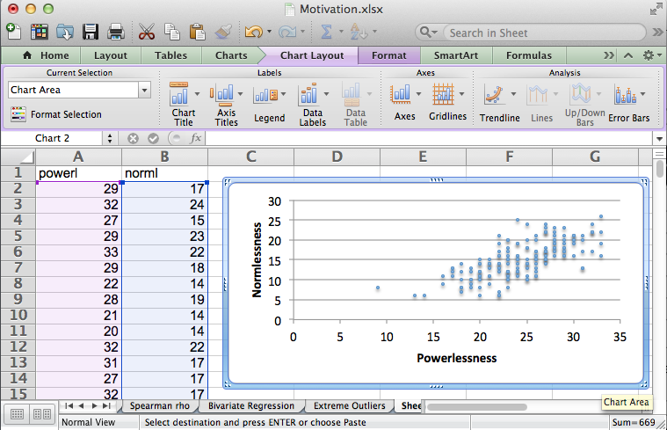
Use the Chart Layout tab and add Powerlessness as the horizontal axis title and normlessness as the vertical axis title (rotated title).
Note: the chart must be selected to make the Chart Layout tab visible.

Slide 8
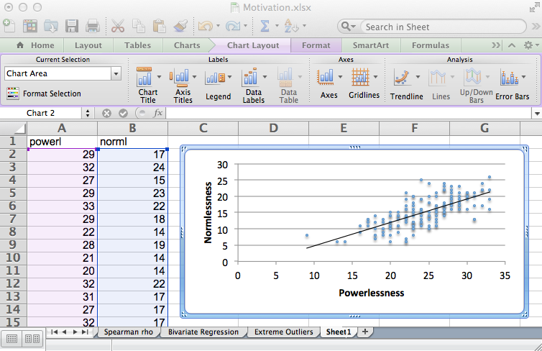
Finally, add a linear trendline.

Slide 9
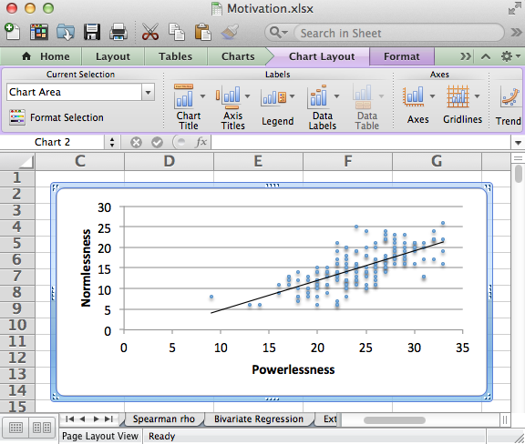
The completed scatterplot suggests a linear relationship exists between powerlessness and normlessness since the amount of change between values on the two variables are close to constant for the entire range of scores for the variables. That is, the plot resembles a cigar-shaped band with no curves, suggesting linearity.

Slide 10
Linearity
End of Presentation

