Slide 1

Statistical Fundamentals:
Using Microsoft Excel for Univariate and Bivariate Analysis
Alfred P. Rovai
Charts
PowerPoint Prepared by
Alfred P. Rovai
Microsoft® Excel® Screen Prints Courtesy of Microsoft Corporation.

Slide 2
Charts
Imagery is the key to understanding statistics
Helps clarify complex data and summary statistics
Supplements the written narrative
One can create and edit a variety of charts using Excel that convey the imagery that promotes meaning and understanding of statistical results.
Most charts share the following characteristics
Two axes that are drawn at a right angle
The horizontal axis is the abscissa, or x-axis
The vertical axis is the ordinate, or y-axis
The independent variable is plotted on the x-axis, and the dependent variable is plotted on the y-axis

Slide 3
Creating a Chart
1
2
3
4
5
Select the data to chart (first column includes data for the x-axis; second column includes data for y-axis)
Highlight the data
Select the type of chart, e.g., column, bar, line, pie, area, scatter, other
Insert the chart type, e.g., 2-D column, 3-D column, cylinder, cone, pyramid, other
Select the chart and modify the chart layout, as desired

Slide 4
Column Charts
A column chart is used to compare categories. The height of the column represents the size of the category defined by the y-axis variable.

Slide 5
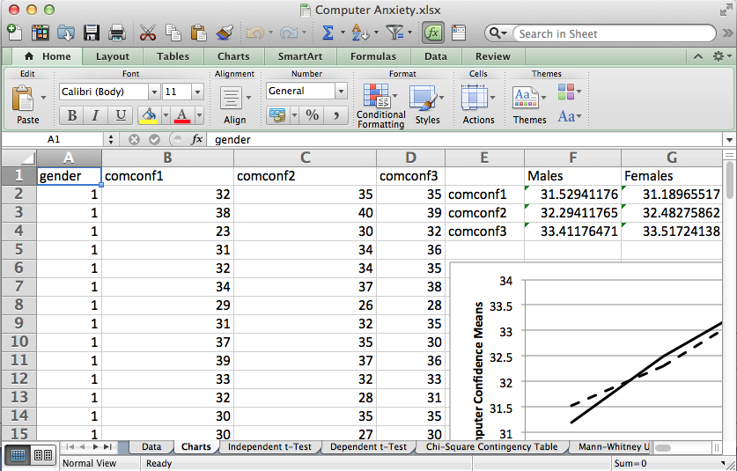
Open the dataset Computer Anxiety.xlsx.
Click the worksheet Charts tab (at the bottom of the worksheet).
File available at http://www.watertreepress.com/stats
TASK
Create a 2-D clustered column chart of computer confidence pretest, computer confidence posttest, and computer confidence delayed test means clustered by gender.

Slide 6
The first step is to create a table of means disaggregated by gender as shown in cells E1:G4.

Slide 7
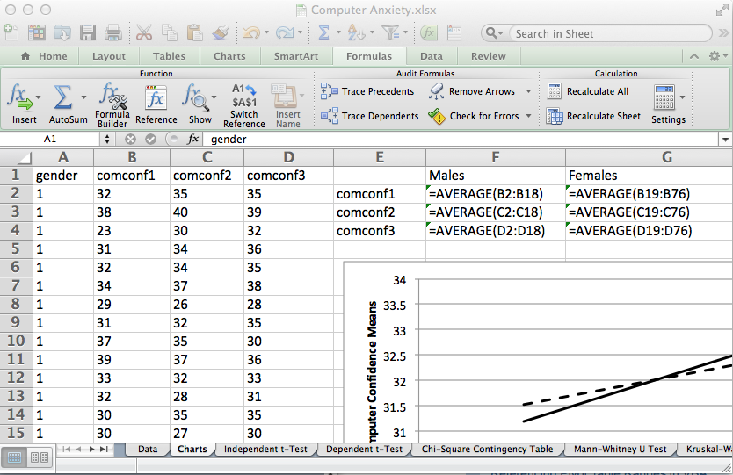
The AVERAGE function is used to calculate means.
AVERAGE(number1,number2,...). Returns the arithmetic mean, where numbers represent the range of numbers.
Enter the labels and formulas shown in cells E1:G4 to generate the means. Note that cases are sorted in ascending order by gender (1 = male, 2 = female). Rows 2 through 18 represent male cases and rows 19 through 76 represent female cases.

Slide 8
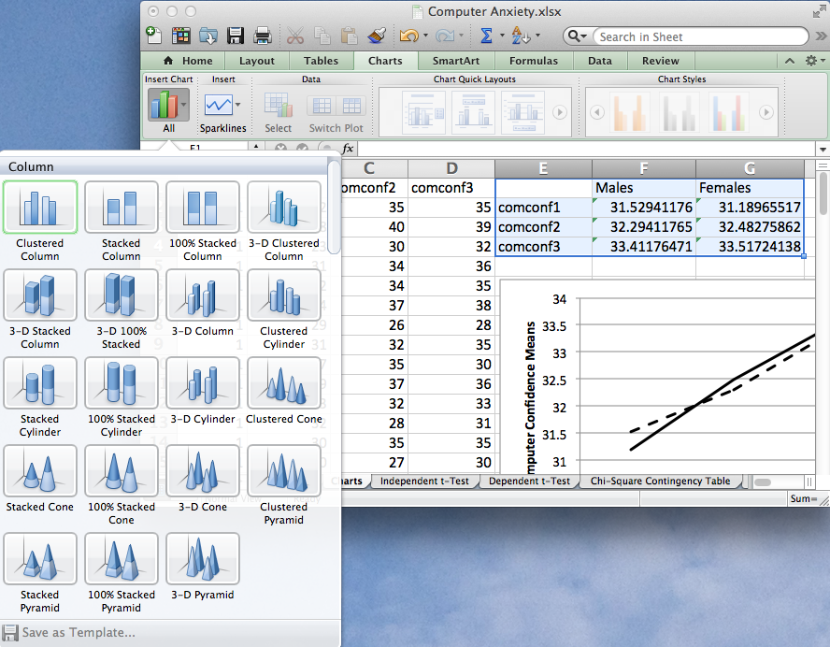
Highlight the range of values to plot, E1:G4.
Select the Charts tab. Click Column on the Insert Chart group of icons.
Select Clustered Column (the 2-D version). The selected chart type appears on the workbook active sheet.

Slide 9
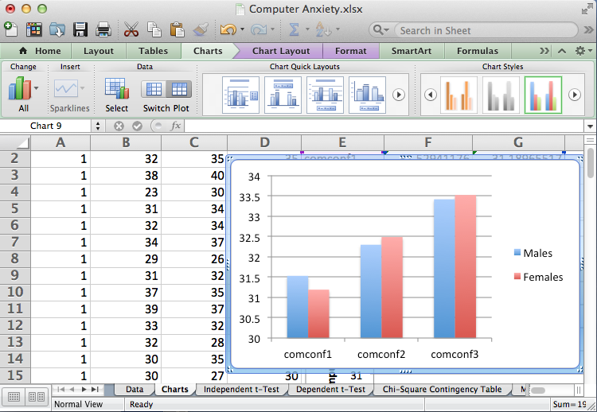
Next, format the column chart as desired. It is often useful to change the default colors to black and white, patterns, or grayscale if the chart is to be printed on a grayscale printer. Journals frequently will not accept color figures for publication.
Start by selecting a blue column and double-clicking it in order to change the color of the blue fill.

Slide 10
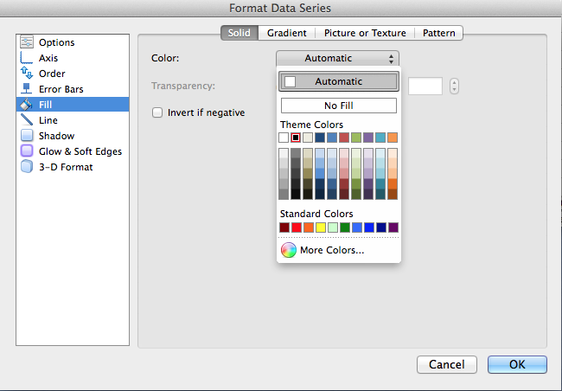
The Format Data Series dialog for the blue (Males) columns appears. Change color from Automatic to black. Click OK.

Slide 11
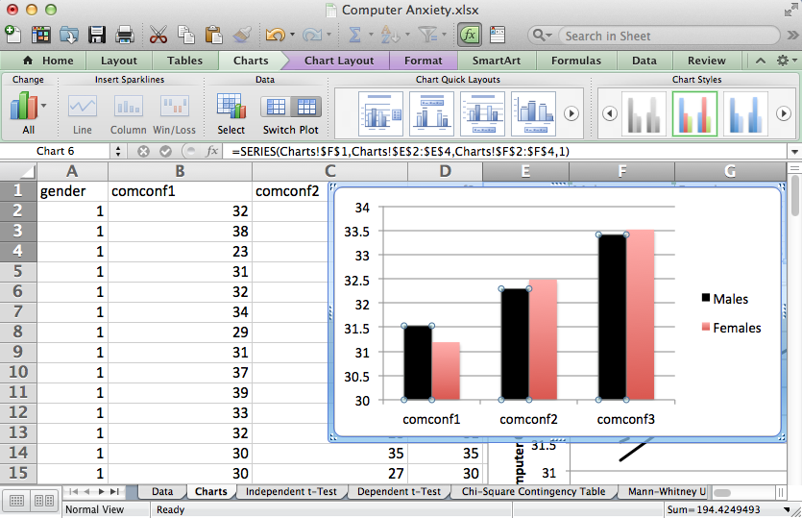
Next, select a red column and double-click it in order to change the color of the red fill.

Slide 12

The Format Data Series dialog for the red (Females) columns appears. Change color from Automatic to gray. Click OK.

Slide 13
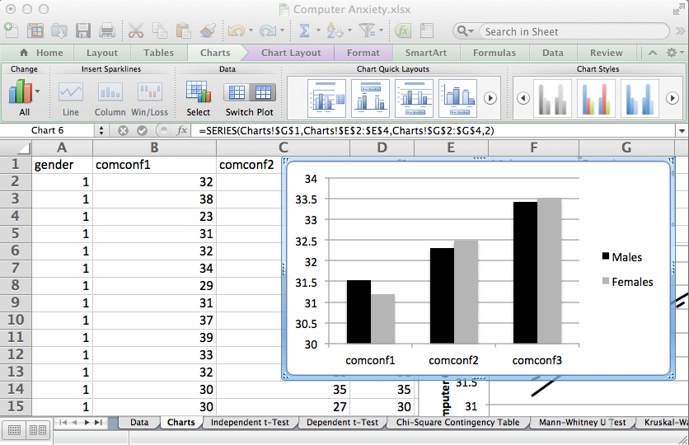
The changes are applied to the chart. Additional changes to the chart can be made as desired.
To use the chart as a figure in a word processing document, select the chart and select Copy from the Excel Edit menu. Then paste the chart in your word processing document.

Slide 14
Scatterplots
Scatterplots (also called scattergrams) show the relationship between two continuous variables by graphing a collection of ordered pairs (x,y). Each dot on a scatterplot represents a case. The dot is placed at the intersection of each case’s scores on the x and y axes.

Slide 15
Scatterplot Uses
Show the strength and direction of relationship between variables
Evaluate the assumption of linearity between pairs of variables
Evaluate the assumption of homoscedasticity between pairs of variables

Slide 16
Interpreting Scatterplots
Negative linear relationship – as x increases, y decreases
Positive linear relationship – as x increases, y also increases.
No relationship – random or shotgun pattern
Curvilinear relationship – concave up or down

Slide 17
Open the dataset Computer Anxiety.xlsx.
Click the worksheet Charts tab (at the bottom of the worksheet).
File available at http://www.watertreepress.com/stats
TASK
Create a scatterplot of computer confidence pretest and computer confidence posttest.

Slide 18
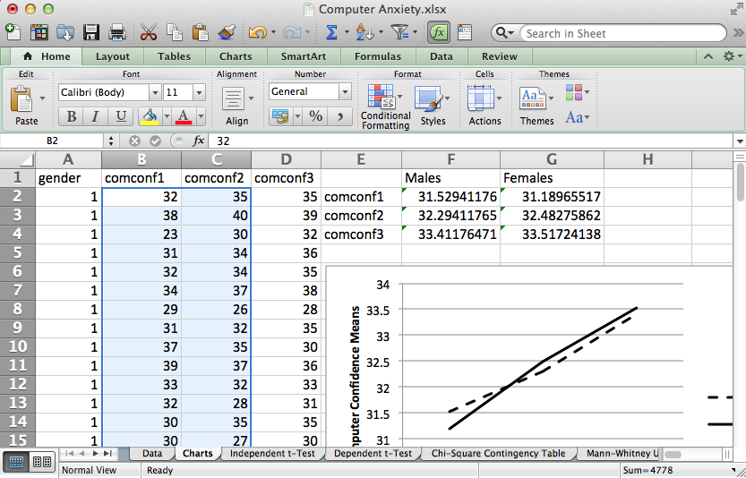
Highlight the range of values to plot, B2:C76, by first clicking the B2 cell and while holding down the Shift key, click the C2 cell and then the C76 cell.
Select the Excel Charts tab toward the top of the worksheet.

Slide 19
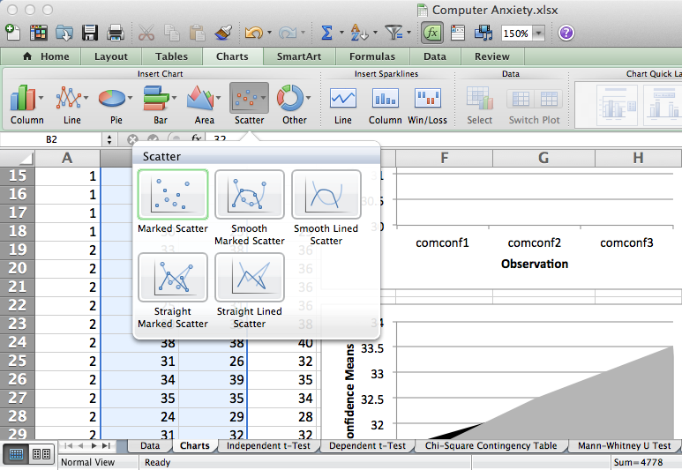
Select Marked Scatter under the Scatter icon. The selected chart type appears on the workbook active sheet.
Excel creates a scatterplot with the variable in the first column (computer confidence pretest) plotted on the x-axis and the variable in the second column (computer confidence posttest) plotted on the y-axis.

Slide 20
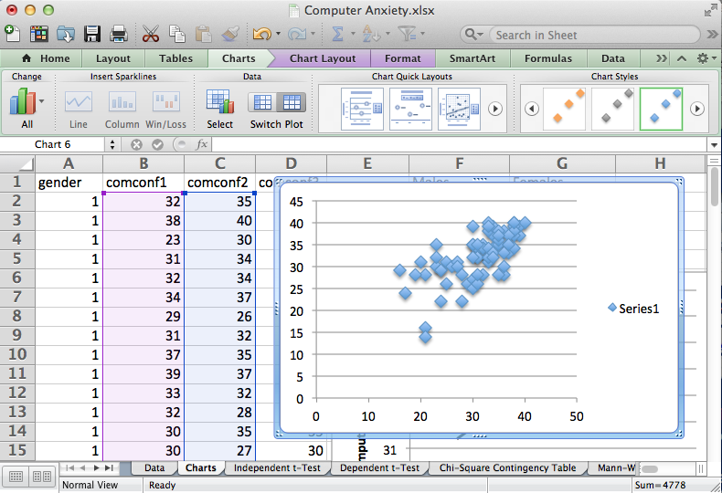
Excel creates the scatterplot
shown on the right. We will now
refine the chart to our liking.

Slide 21
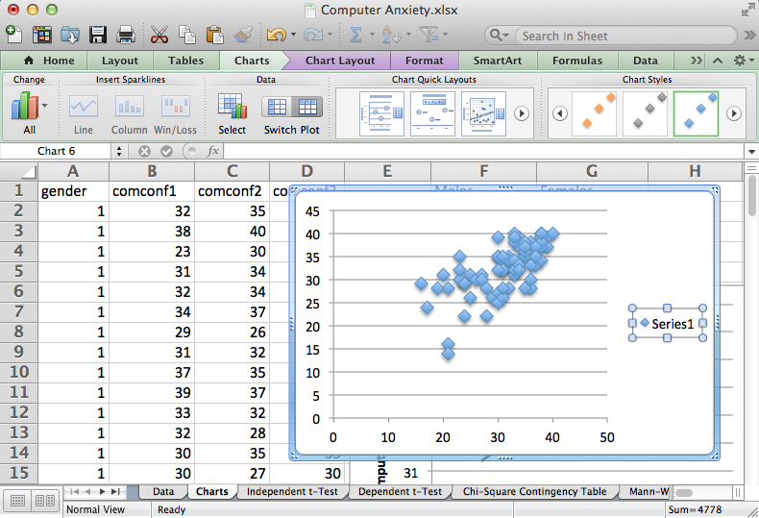
Click on the legend (Series 1)
in order to select it. Then hit the
Delete key to delete it.

Slide 22
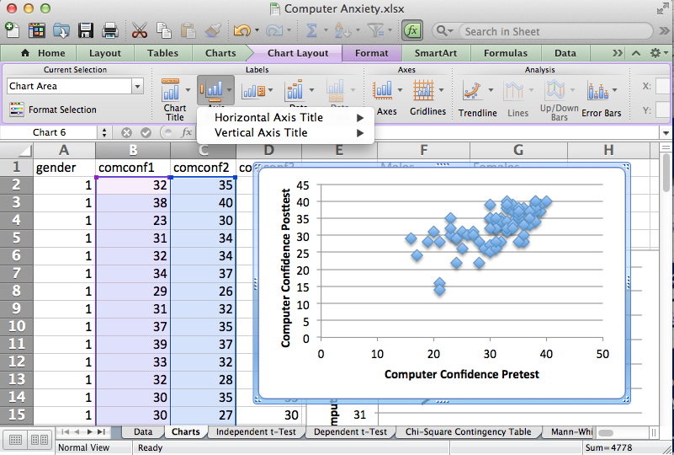
Select the Excel Chart Layout tab toward the top of the worksheet.
Click the Axis Titles icon in the Chart Layout tab and enter titles for the horizontal-axis (Computer Confidence Pretest) and vertical-axis using the Rotated Title option (Computer Confidence Posttest).

Slide 23
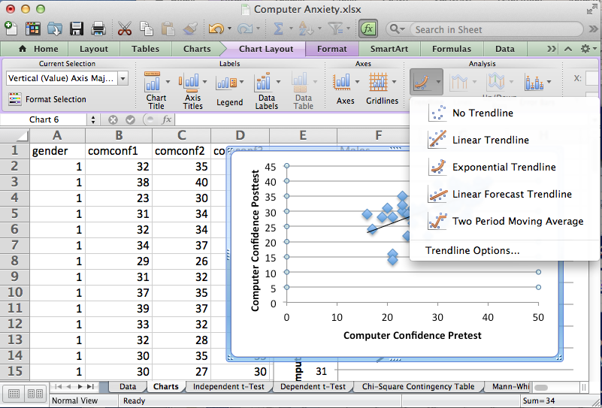
One can add a trendline, if desired, using the Trendline icon. This is useful if the purpose of the scatterplot is to evaluate linearity between the two variables.
Select Linear Trendline.

Slide 24
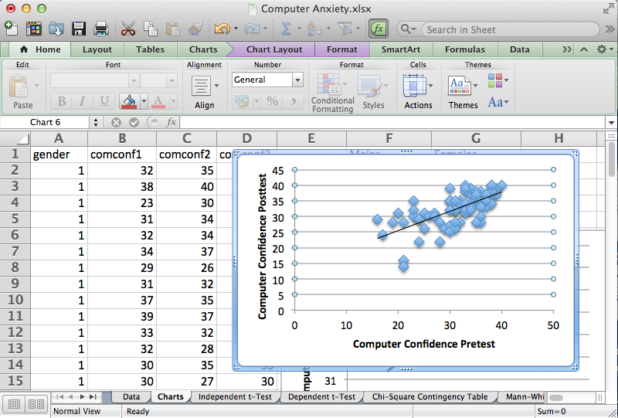
The scatterplot reveals a mostly linear relationship between computer confidence pretest and computer confidence posttest.
We can further refine the scatterplot by changing the marker style to circles and reducing marker size.

Slide 25
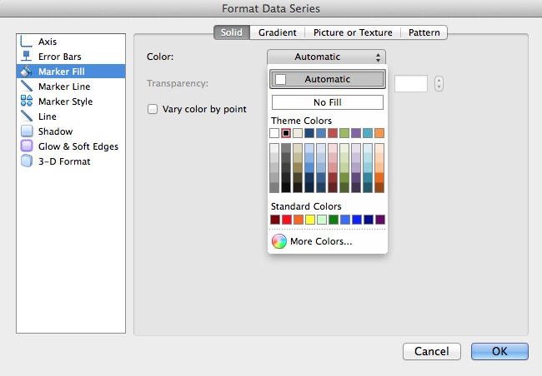
Double-click any marker on the scatterplot to launch the Format Data Series dialog. Select Marker Fill and black as the theme color.
Click OK to apply the change.
Double-click any marker on the scatterplot to again launch the Format Data Series dialog.

Slide 26
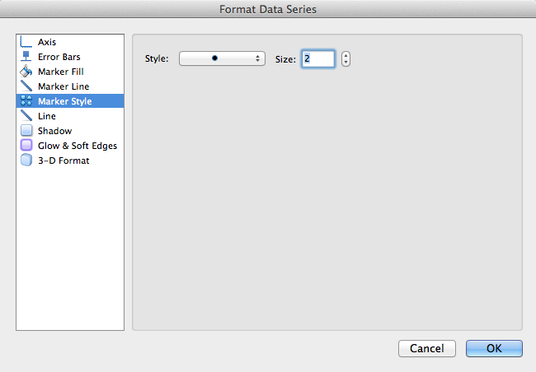
Select Marker Style to circle and change size from 9 (default) to 2.
Click OK to apply the change.
The smaller size will increase resolution and facilitate interpreting the scatterplot.

Slide 27
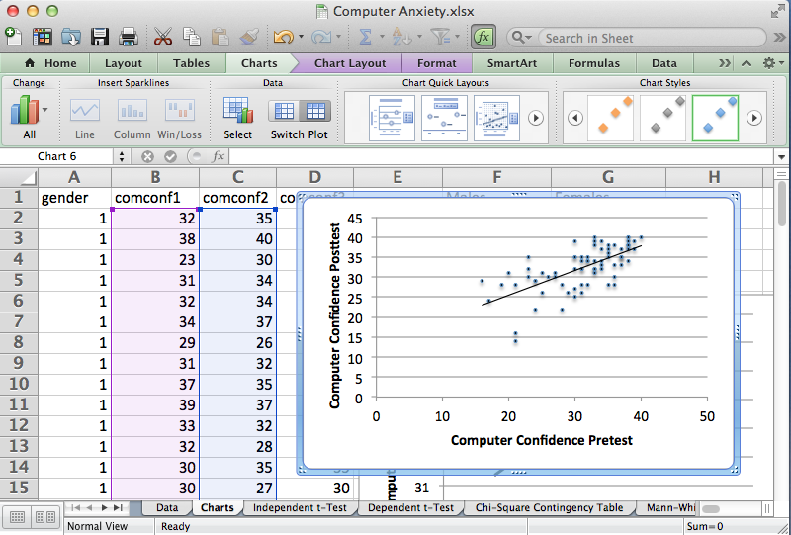
The chart to the right is the resultant scatterplot. It depicts a moderate and direct (positive) relationship between the two variables. That is, as one variable increases so does the other.
To use the chart as a figure in a word processing document, select the chart and select Copy from the Excel Edit menu. Then paste the chart in your word processing document.

Slide 28
Histogram
A histogram is used to evaluate the shape of a distribution. It is a frequency curve that displays a univariate dataset.

Slide 29
Histogram Construction
Divide the range of continuous data into equal-sized adjacent bins (classes or groups) along the x-axis.
It is helpful to view these bins as fixed-interval containers that accumulate data that causes the bins to increase in height.
For each bin, a rectangle is constructed with an area proportional to the number of observations falling into that bin.
Bins are plotted on the x-axis and frequencies (the number of cases accumulated in each bin) are plotted on the y-axis. The y-axis ranges from 0 to the greatest number of cases deposited in any bin. The x-axis includes the entire data range.
The total area of the histogram is equal to the number of data points.

Slide 30
Creating a Histogram
Determine the number of bins. There is no single rule regarding the number of bins displayed by a histogram. Different size bins often reveal different characteristics of a distribution, so experimentation with the number of bins is often useful. A popular formula for determining the minimum number of bins (k) in a distribution is given below (must be 6 or higher).

Slide 31
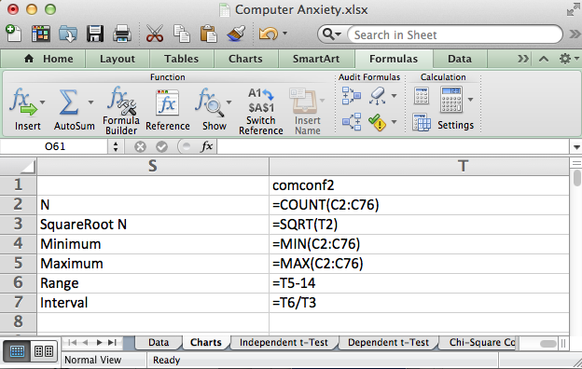
Calculate N, √ N, Minimum, Maximum, Range and Interval using the formulas shown in cells T2:T7.

Slide 32
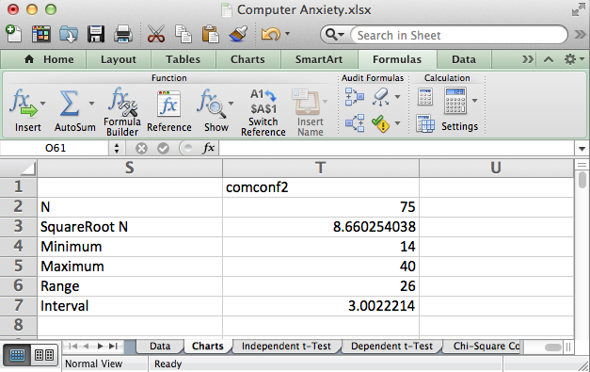
Round up the square root of N to identify the minimum number of bins. Round down the interval to identify maximum bin width. In this example the histogram will include 9 bins with a bin width of 3.

Slide 33
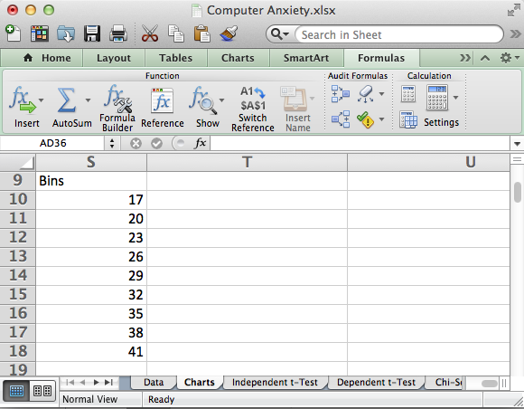
Create a label and set of bin upper boundary values for the histogram in cells S9:S18. Identify the first bin by adding the bin width to the minimum value (rounded). Then identify the upper boundary of subsequent bins by adding the bin width (3) to the previous upper bin boundary as shown on this worksheet.

Slide 34
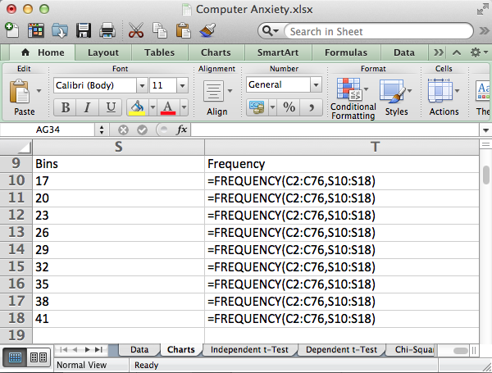
Next, enter “Frequency” as a label in cell T9. Then highlight cells T10:T18 and enter the array formula “=FREQUENCY(C2:C76,S10:S18)” and hit the CTRL-SHIFT-ENTER (or RETURN) buttons at the same time.

Slide 35
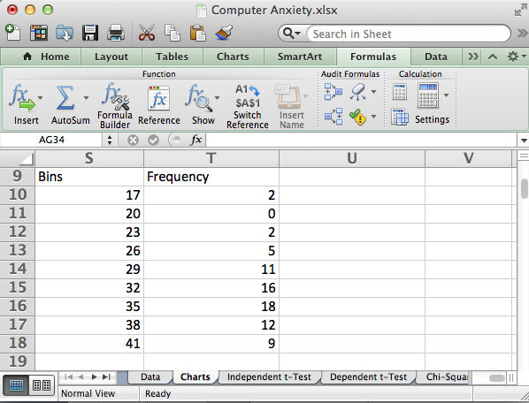
Excel produces a frequency table for the bins (class intervals). This table will be used to generate the histogram.

Slide 36
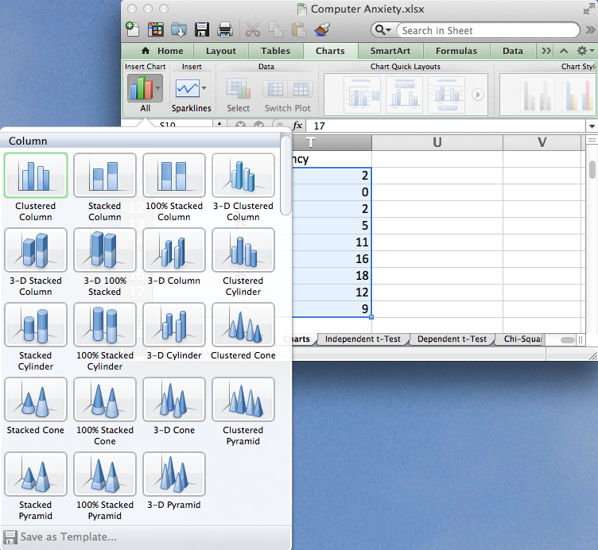
Highlight the range of values to plot, T10:T18.
Select the Charts tab. Select 2-D Clustered Column (the drop-down menu allows selection of a variety of column charts). The selected chart type appears on the workbook active sheet.

Slide 37
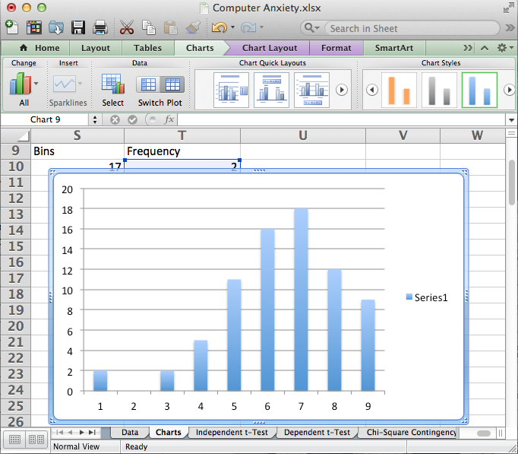
Highlight the legend (Series 1) and hit Delete. Double-click a column to open the Format Data Series dialog. Select Options and change gap width from 150% (default) to 0%. Also, select Line and select black as the color so that columns are outlined in black. Click OK to close the dialog and make the changes.

Slide 38
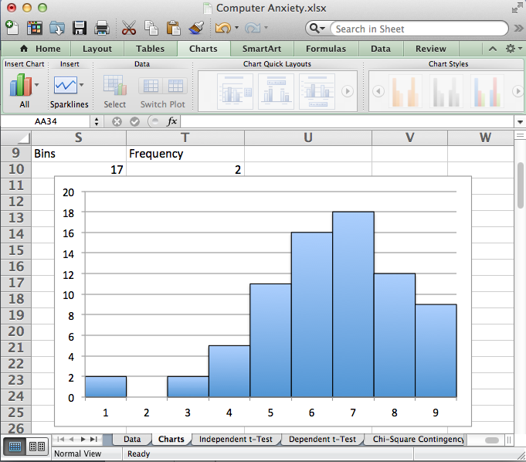
The result is a histogram that displays computer confidence posttest bin numbers on the x-axis. It reveals a non-symmetrical, negatively-skewed shape that deviates from normality.

Slide 39
Pie Chart
A pie chart is a circular chart that is divided into sectors or slices to show proportions (i.e., relative size of data). Useful for comparing proportions and showing how data are distributed. Data to chart are usually presented in a two-column table format, e.g., a frequency table.

Slide 40
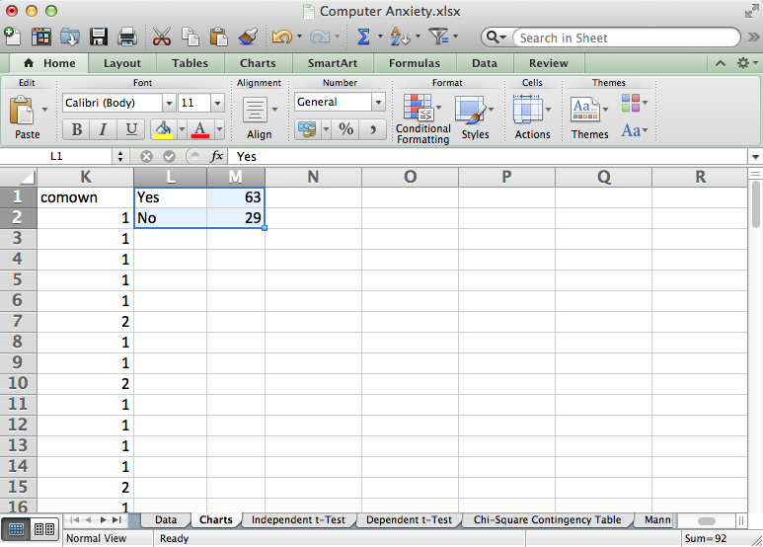
The first step is to create a frequency table as shown in cells L1:M2.
Highlight the range of values to plot, L1:M2 in the above example.
Select the Charts tab. Click Pie on the Insert Chart group of icons.
Select 2-D Pie chart (the drop-down menu allows selection of a variety of pie charts). The selected chart type appears on the workbook active sheet.

Slide 41
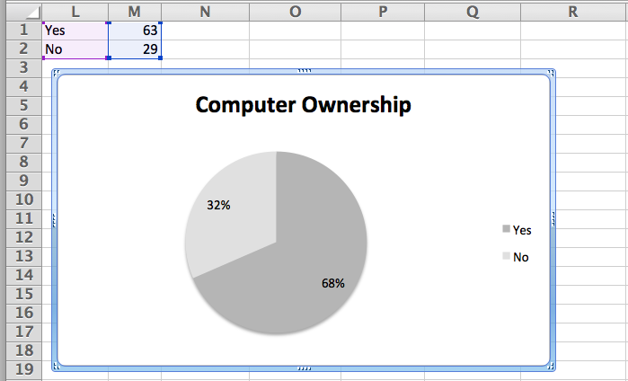
The chart can now be modified as desired by using tools available under the Excel Charts and Chart Layout tabs.

Slide 42
Charts
End of Presentation

